Slide 1
IT and IS in a Business Context
Business Environment
The Business
Business Process
Information System
Information Technology

Slide 2
Work Centred Analysis (WCA) Framework
A Framework is a brief set of ideas for organising a thought process about a particular type of thing or situation.
WCA combines ideas from TQM, BPR, and systems theory;
Consists of 6 linked elements:
The internal and external customers of business process
The products and services generated by the business process
The steps in the business process
The participants in the business process
The information the business uses or generates
The technology the business process uses

Slide 3
WCA Framework
Customers
Products
Information
Participants
Business Process
Technology

Slide 4
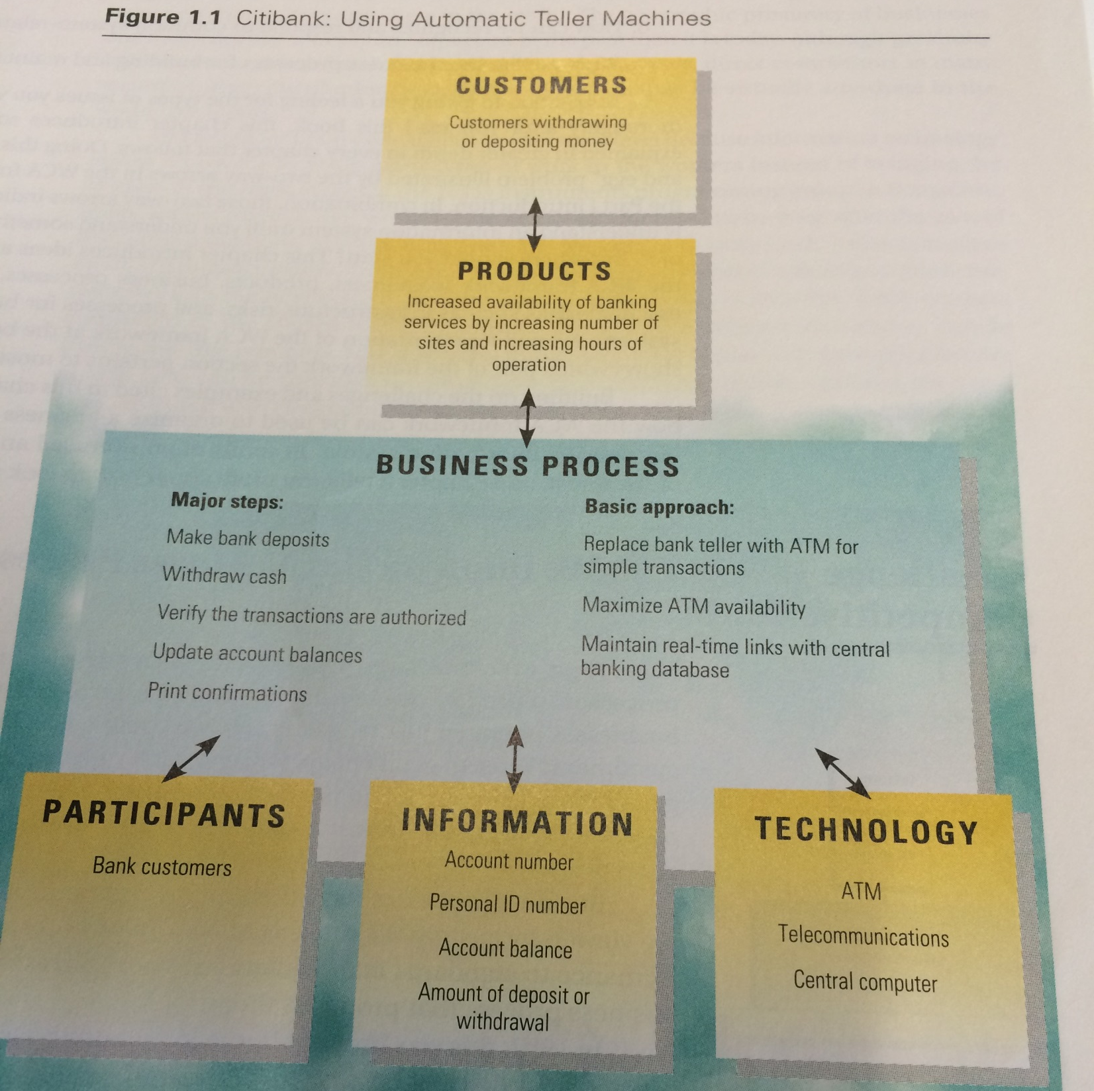

Slide 5
Seven Management Challenges
How can we improve Business processes in today’s competitive world?
How can we benefit from today’s trends and innovations?
How can we achieve maximum benefit from information?
How can we extend our human skills and motivate our people?
How can we make the most of the surrounding infrastructure and context?
How can we recognise and respond to common system-related risks?
What are the best business processes for building and maintaining our systems?

